Slide 1
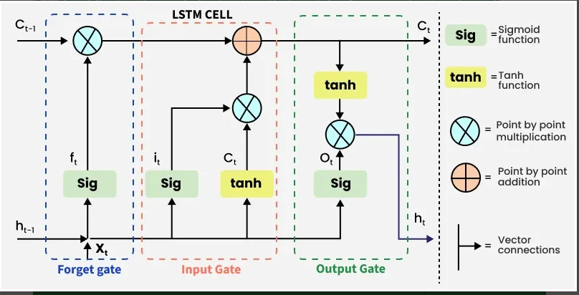
Long Short-Term Memory (LSTM) model
Long Short-Term Memory (LSTM) is a specialized type of Recurrent Neural Network (RNN) designed to model sequential data and capture long-term dependencies. Introduced in 1997 by Sepp Hochreiter and Jürgen Schmidhuber, LSTMs were specifically created to solve the vanishing gradient problem, where traditional RNNs fail to retain information from many time steps ago because gradients shrink during training.

Slide 2
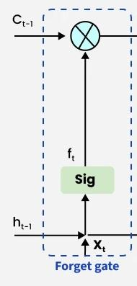
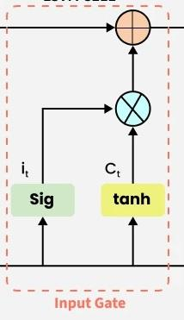
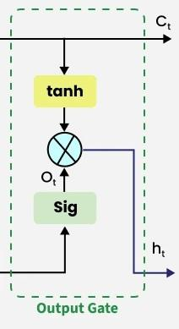
FORGET INPUT AND OUTPUT GATES DIAGRAM
FFFFFFFFFFFFF

Slide 3
.
Normal RNNs struggle to remember information for a long time due to the vanishing gradient problem, but LSTM solves this issue by using a memory mechanism.
LSTM remembers important past information and forgets unnecessary data.
How an LSTM Works: The Three Gates
LSTMs use three "gates" to regulate which information is kept, added, or released from the cell state. These gates are neural networks themselves that use a sigmoid activation function, outputting values between 0 (reject all) and 1 (keep all).
Forget Gate:
Decides what information from the previous cell state is no longer useful and should be discarded.
Formula: t​=σ(Wf​⋅[ht−1​,xt​]+bf​)
Example: In a language model, if a new subject is introduced, the gate may "forget" the gender of the old subject.

Slide 4
2. Input Gate:
Determines which parts of the new input should be stored in the cell state. It creates a "candidate" vector of new information and uses the gate to decide how much of it to actually add.
Formula: it​=σ(Wi​⋅[ht−1​,xt​]+bi​)
3. Output Gate:
Selects which parts of the updated cell state will be output as the hidden state for the current time step.
Formula: Ct​=ft​⊙Ct−1​+it​⊙C~t​
Why LSTMs are Effective
Handles Long Dependencies: Their gate mechanism allows them to remember crucial information from much earlier in a sequence.
Solves Vanishing Gradient: The cell state's additive updates prevent gradients from shrinking too much during backpropagation, a common RNN issue.

Slide 5
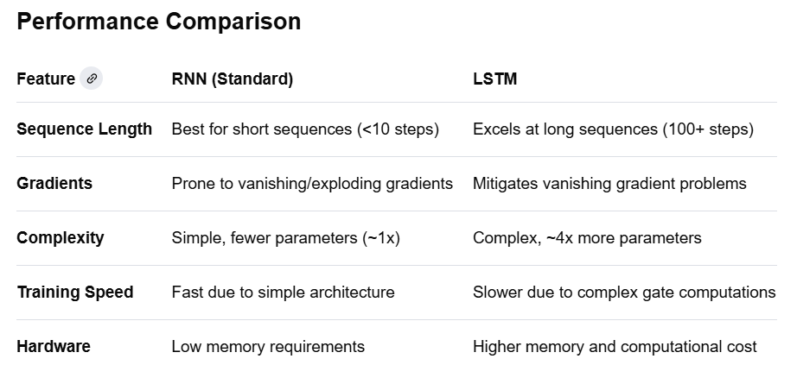

Slide 6
LSTM SOLVE THE VANISHING GRADIENT
Vanishing Gradient Problem
Vanishing Gradient Problem: One challenge with traditional RNNs is the "vanishing gradient" problem. During backpropagation, gradients can become extremely small when training on long sequences, making it difficult for the network to learn long-term dependencies. As a result, traditional RNNs may struggle to capture information from distant past time steps
SOLUTION
LSTM solves the vanishing gradient problem by using a special structure called a cell state, which carries information across long sequences with minimal changes.
Gates (forget, input, and output) control what information to keep, add, or remove from the cell state.
The sigmoid function filters values between 0 and 1, while tanh keeps activations between -1 and 1.
This controlled flow prevents gradients from shrinking during backpropagation.
As a result, LSTM can remember long-term dependencies effectively.

Slide 7
ADVANTAGES OF LSTM
LSTM can remember long-term dependencies in sequence data.
It solves the vanishing gradient problem present in traditional RNNs.
Gates allow controlled flow of information, improving learning efficiency.
LSTM works well for time series, language, and speech-related tasks

Slide 8
DISADVANTAGES OF LSTM
LSTMs are computationally expensive due to multiple gates and parameters.
They require more memory than simple RNNs.
Long training time is needed, especially for large sequences.
Performance depends on large datasets; small datasets may cause overfitting.
The architecture is complex, making tuning and implementation harder

Slide 9
APPLICATIONS OF LSTM
1. Natural Language Processing (NLP)
Language modeling, text generation, machine translation, and sentiment analysis.
2. Speech Recognition
Converting spoken words into text accurately by learning long-term patterns in audio sequences.
3. Time Series Prediction
Stock prices, weather forecasting, and sales predictions, where past information influences the future.
4. Anomaly Detection
Detecting unusual patterns in data streams like network traffic or machinery sensors.
5. Handwriting and Gesture Recognition
Learning sequences in handwritten text or motion data.
6. Music and Video Generation
Predicting sequences of notes or video frames in creative AI applications.

